Slide 1
AR Indoor Navigation for
SKKU Suwon campus
team E: 김현호 마준서 안정민 조민구

Slide 2
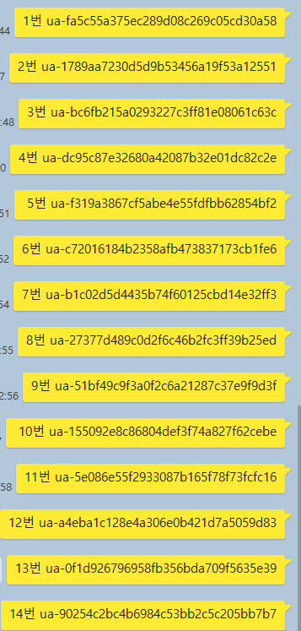
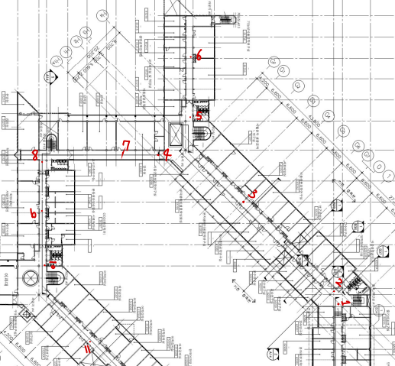
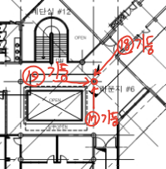

AR Anchor issue

Slide 3

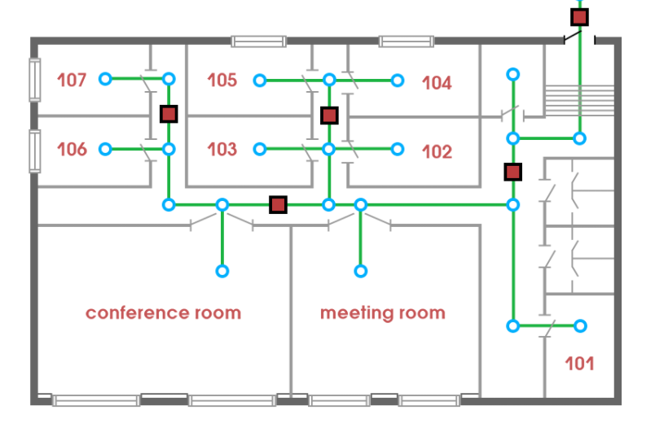
Navigation System Issue

Slide 4
Navigation System Issue
…
…

Slide 5
Navigation System Issue - case1: nearest section

Slide 6
Navigation System Issue - case1: nearest section
1
2
3
4

Slide 7
Navigation System Issue - case1: nearest section
2
1
3
4
6
5

Slide 8
Navigation System Issue - case2: nearest section + distance

Slide 9
Navigation System Issue - case2: nearest section + distance

Slide 10
Navigation System Issue - case2: nearest section + distance

Slide 11
Navigation System Issue - case2: nearest section + distance
?

Slide 12
Navigation System Issue - case3: Shortest dijkstra
22
3
3
1
1
2
2
1
1
3
3
4
4
45

Slide 13
Navigation System Issue - case3: Shortest dijkstra
2
1
3
4
5

Slide 14
Navigation System Issue - case3: Shortest dijkstra
2
1
3
4

Slide 15
Navigation System Issue - case3: Shortest dijkstra
1
2
3

Slide 16
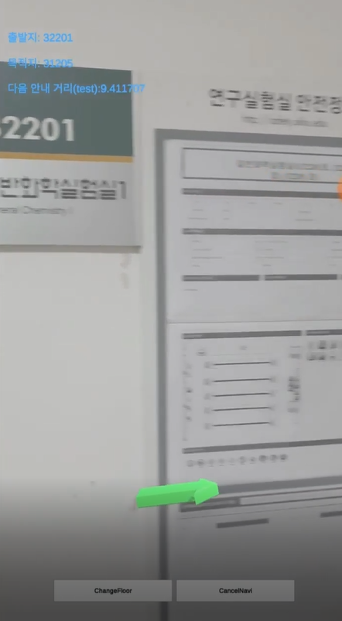
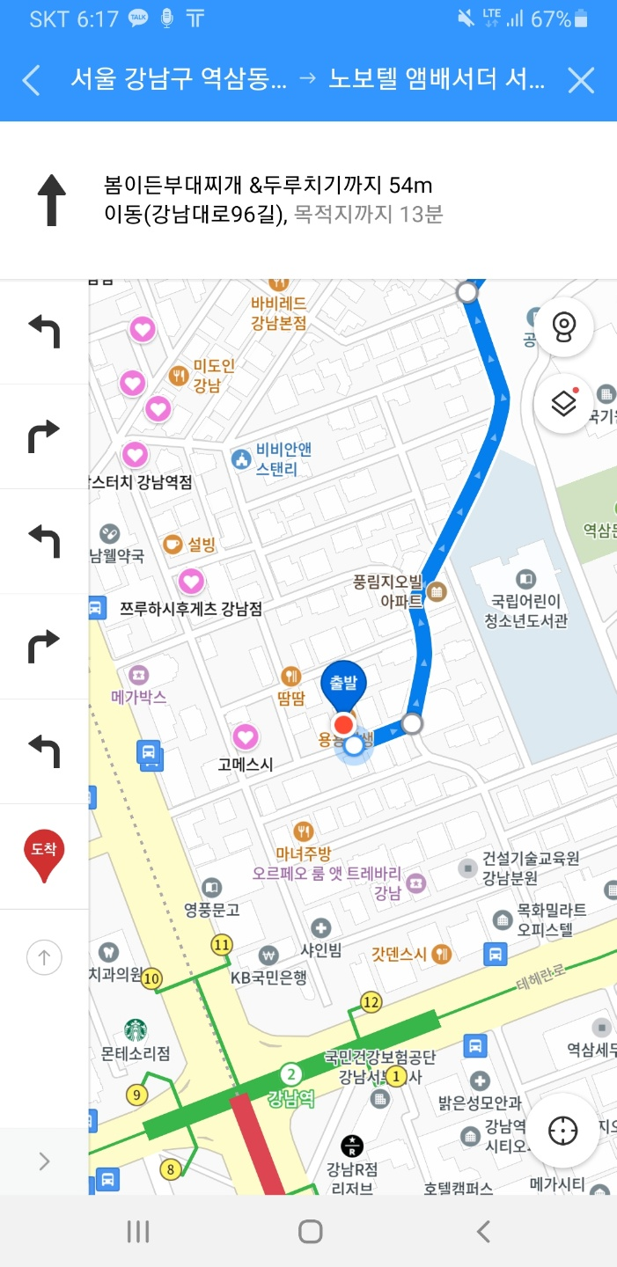
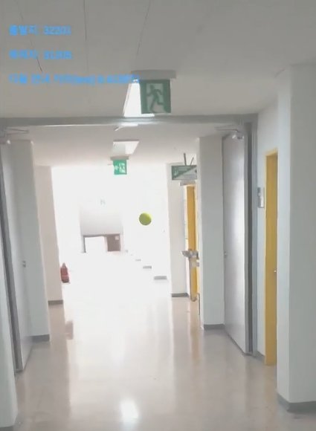
Navigation Method
Guide Arrow
Guide Branch
Guide Information Sign

Slide 17
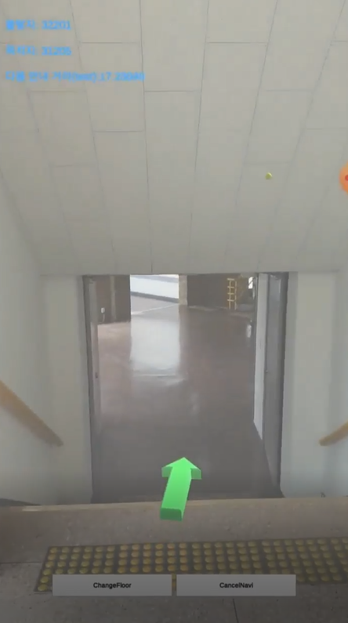
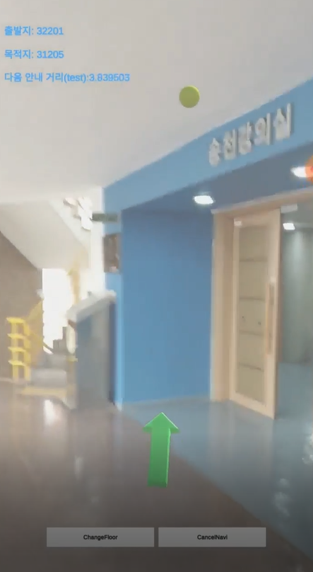
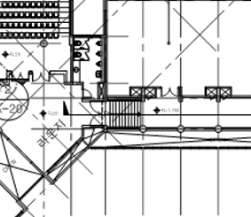
Navigation Method Issue - User height change

Slide 18
Navigation Method Issue - User height change

Slide 19
Navigation Method Issue - User height change

Slide 20
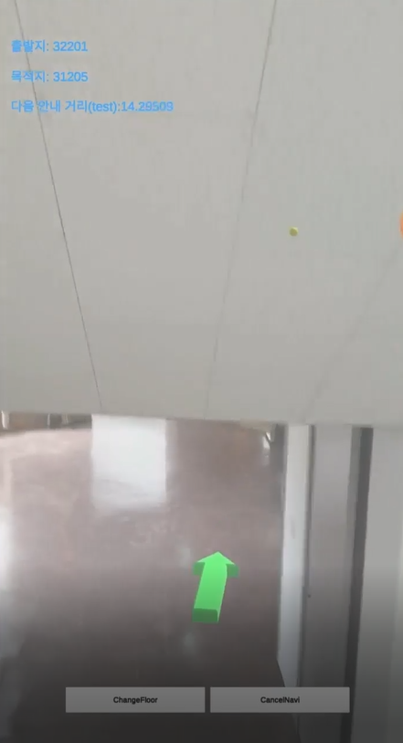
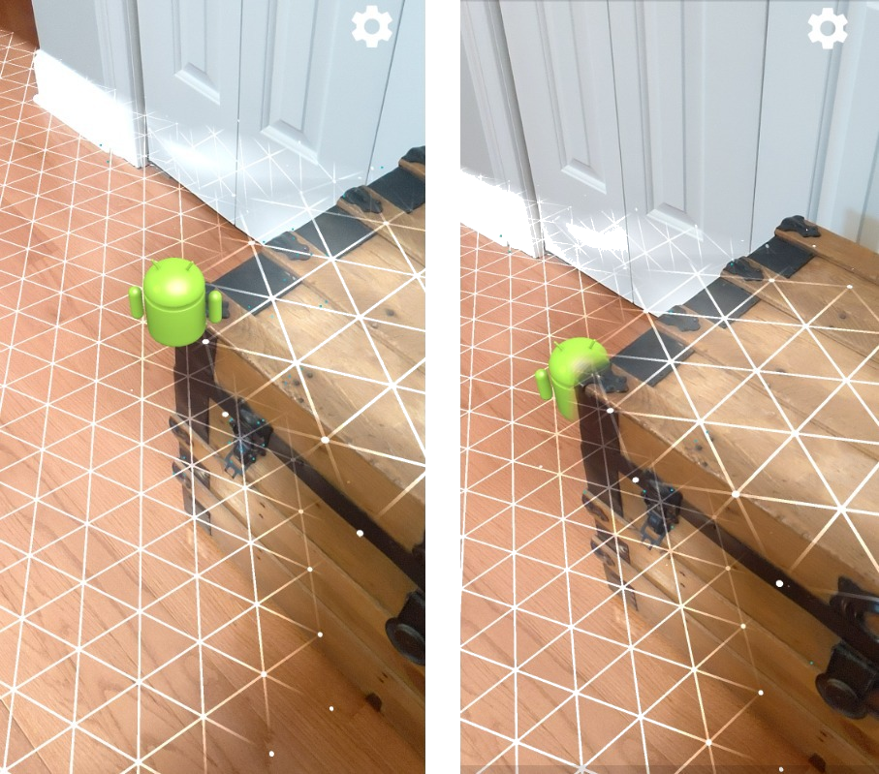
Navigation Method Issue - Wall Occlusion

Slide 21
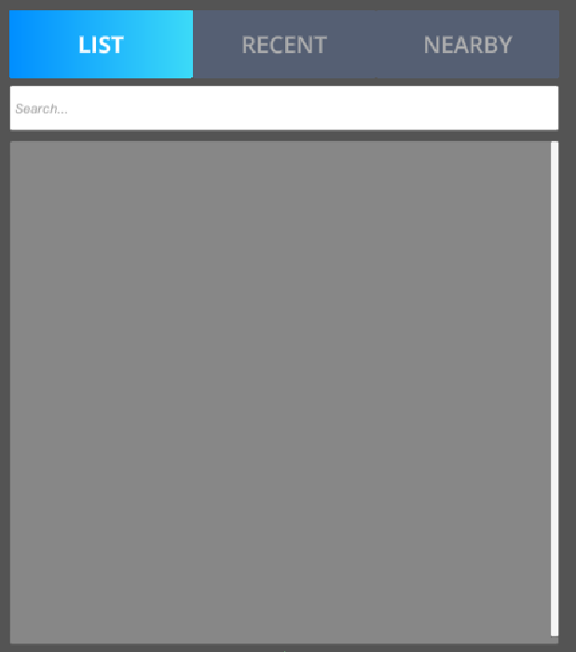
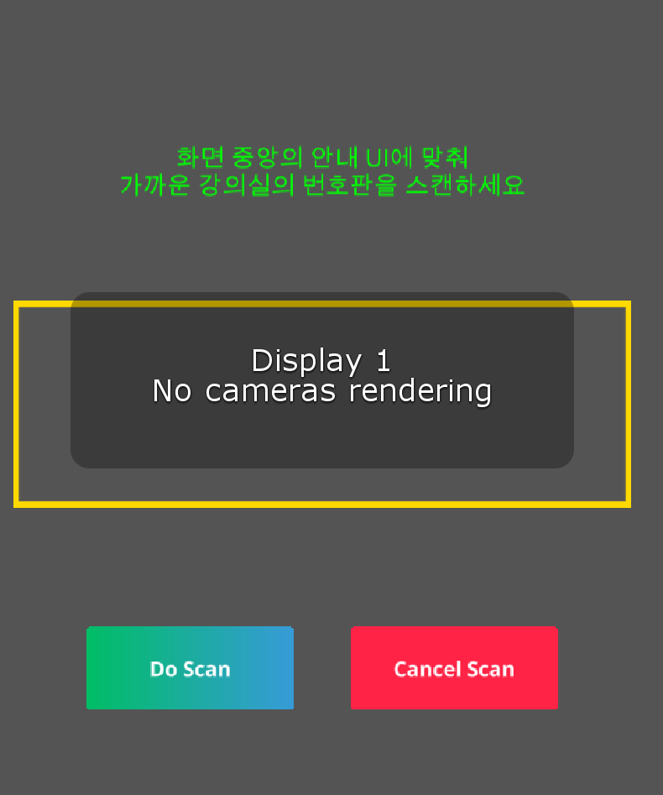
UI

Slide 22
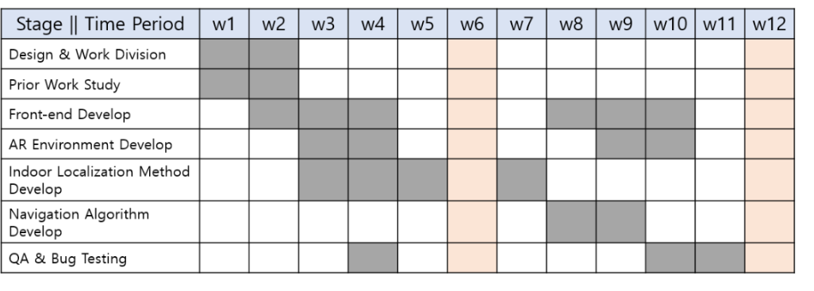
To Do

Slide 23
To Do
-AR Anchor Correction Test
-Navigation Method Test
-Floor Change Test
-fix AR UI problem

